Slide 1
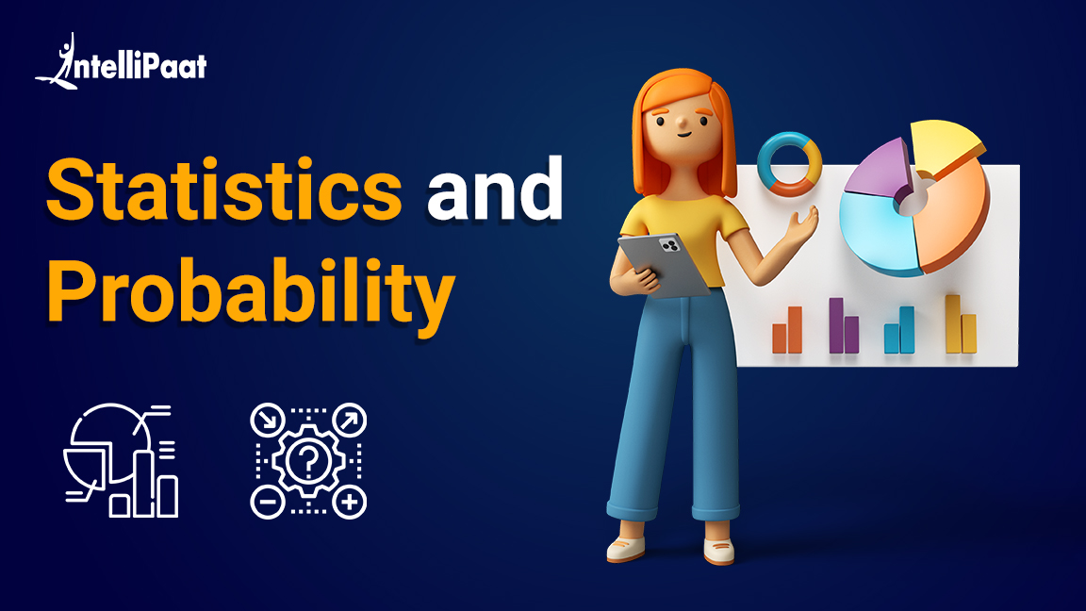

Slide 2

01
02
Intro to Statistics
Sampling
03
04
Central Tendencies
Variation
05
Correlation

Slide 3
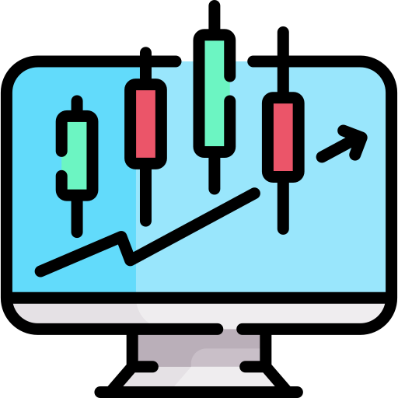
Introduction to Statistics

Slide 4
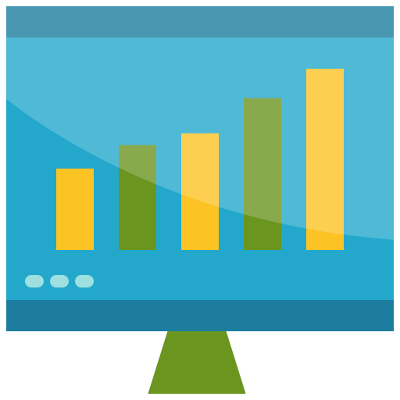
What is Statistics?

Slide 5
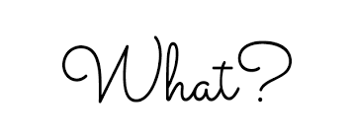

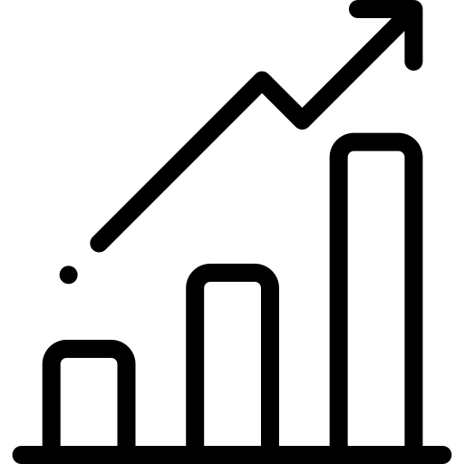
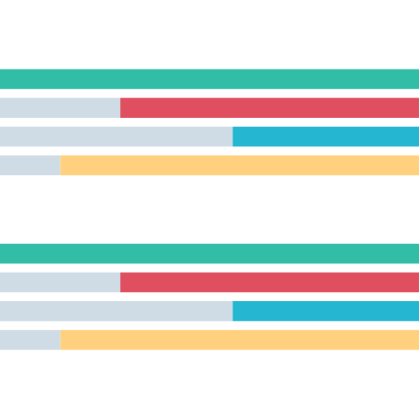
What is Statistics?
Statistics is a branch of Mathematics that deals with collection, analyzing, and interpreting large amounts of data.

Slide 6
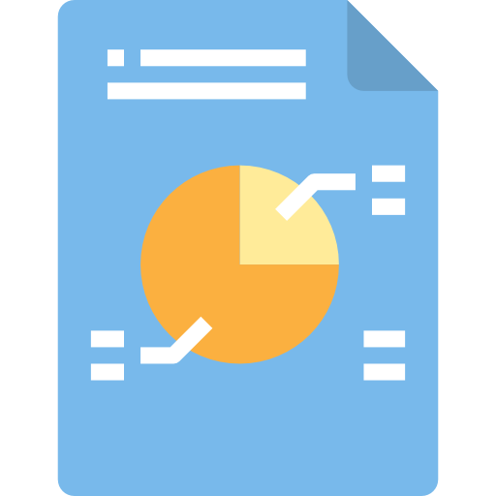
Why is Statistics important?

Slide 7
Why is Statistics important?
Statistics allows us to derive knowledge from large datasets and this knowledge can then be used to make predictions, decisions, classifications etc.

Slide 8

Where is Statistics used?

Slide 9

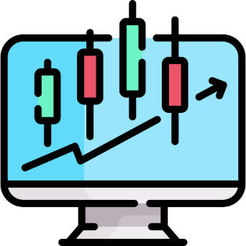


Where is Statistics used?
Statistics are used in various fields, some of them are:
Medical Research
Stock Market
Sales Projection
Weather Forecasting

Slide 10

Sampling

Slide 11


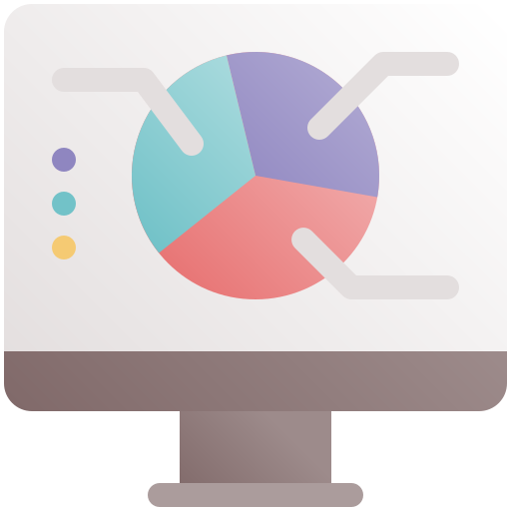
Sampling
Sampling is the process of collecting data to perform analysis on

Slide 12

Sample vs Population

Slide 13
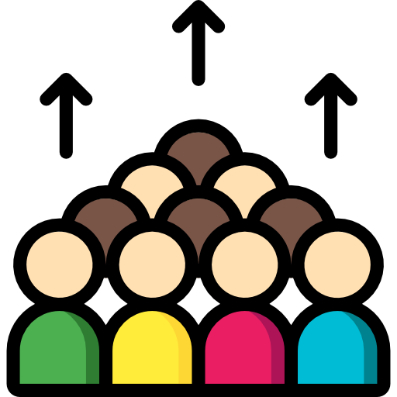


Sample vs Population
Population is the entire dataset such as the whole population of a country, Sample is subset of that population which is analyzed to make inferences

Slide 14

Random Sampling

Slide 15
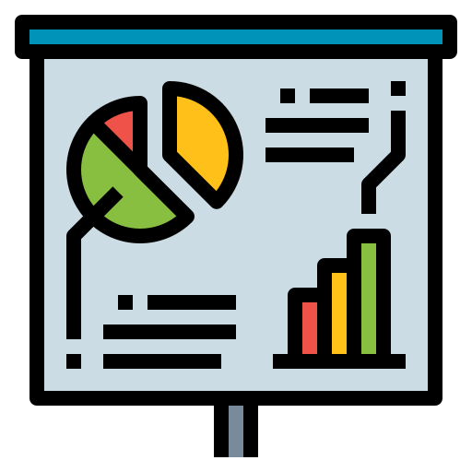


Random Sampling
Random Sampling is the process of selecting a subset / sample from a population in such a way that every data point is equally likely to be included in the sample

Slide 16
Stratified Sampling

Slide 17
Stratified Sampling
Stratified Sampling is the process of dividing your samples into layers or groups and then performing random sampling for each group

Slide 18

Central Tendencies

Slide 19
Central Tendencies
Central Tendency is used to indicate where does the middle or center of the distribution of our data lies

Slide 20

Mean

Slide 21
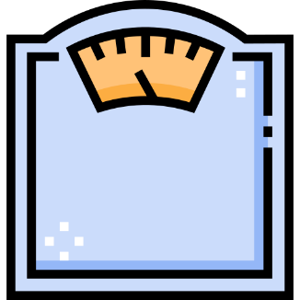
Mean
Mean is the average of the data. In simpler terms it’s the sum of values divided by total number of values. It’s represented by Greek letter Sigma
Mean

Slide 22

Mode

Slide 23

Mode
Mode is used to indicate the most frequent data point, in other words the one which occurs most number of times
Mode

Slide 24
Median

Slide 25

Median
Median is the middle of the data. If the data is arranged in ascending order then the data element which occurs right at the center is the median
Median

Slide 26
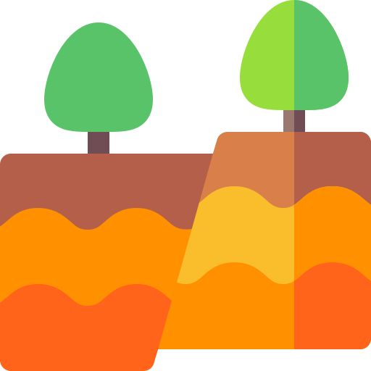
Variation

Slide 27



Variation
Variation in statistics is used to show how data is dispersed, or spread out. Several measures of variation are used in statistics.
Range
Quartiles
Variance

Slide 28

Range

Slide 29
Range
Range is the difference between the highest and the lowest values in our dataset. Range tells us the distance between the lowest and highest values in our data

Slide 30
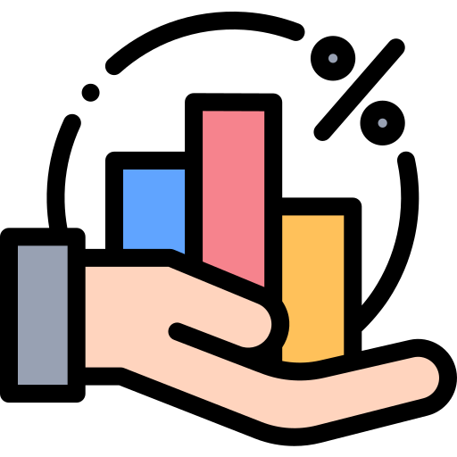
Percentiles

Slide 31
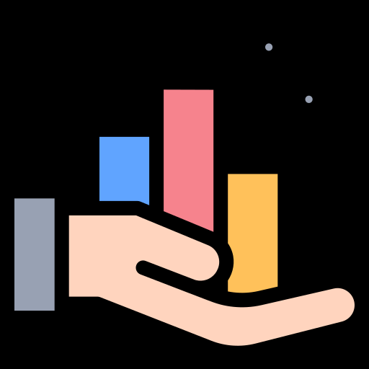
Percentiles
Percentiles are scores that are used to describe a value below which some Observations fall.
E.g.: If X is at 70th Percentile it mean 70% of other data points from our sample are below X

Slide 32

Quartiles

Slide 33
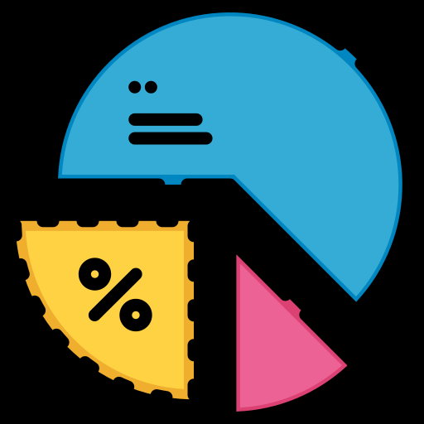
Quartiles
Quartiles are used to break the data into 4 parts so as to better find the spread of data in a way that is less influenced by outliers.
Quartiles are expressed in percentiles. 1st Quartile is 25th Percentile, 2nd Quartile is 50th Percentile (Median) and 3rd Quartile is 75th Percentile

Slide 34
Interquartile Range (IQR)

Slide 35
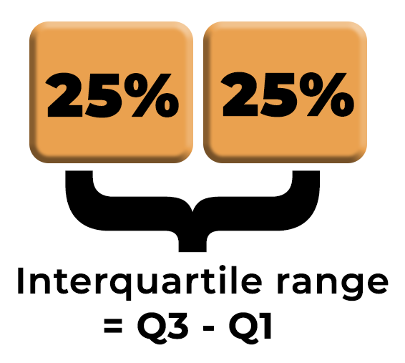
Interquartile Range (IQR)
Interquartile Range (IQR) is the difference between the lower and upper quartile. This gives us a better idea of the range of data.

Slide 36

Standard Variance and Standard Deviation

Slide 37
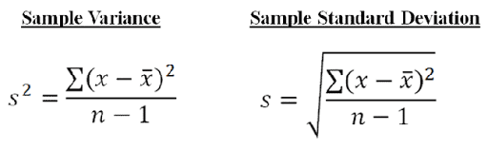
Standard Variance and Standard Deviation
Standard Variance measures how far a set of numbers are spread out from their average value.
Standard Deviation is used to express the magnitude by which the members of a group differ from the mean value for the group.
Standard Deviation is the square root of Standard Variance.

Slide 38

Correlation

Slide 39
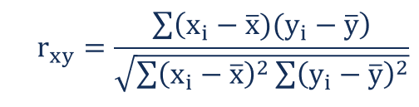
Correlation
Correlation is a term that is a measure of the strength of a linear relationship between two quantitative variables

Slide 40

Positive Correlation

Slide 41

Positive Correlation
Positive Correlation is a term that is used to describe a positive linear relationship between two quantitative variables
Positive Correlation

Slide 42

No Correlation

Slide 43
No Correlation
No Correlation is a term used to describe no linear relationship between two quantitative variables
No Correlation

Slide 44
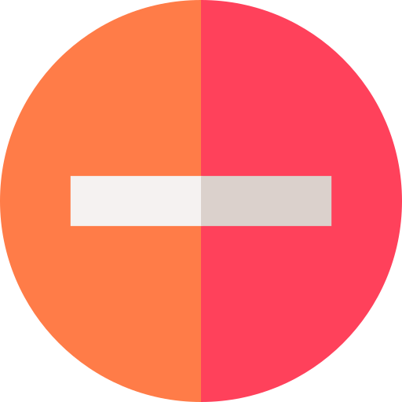
Negative Correlation

Slide 45
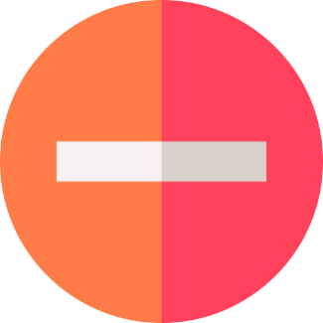
Negative Correlation
Negative Correlation is a term that is used to describe the strength of a Negative linear relationship between two quantitative variables
Negative Correlation

Slide 46



India: +91-7847955955
US: 1-800-216-8930 (TOLL FREE)
sales@intellipaat.com
support@intellipaat.com
24/7 Chat with Our Course Advisor

